Slide 1
CS 440: Intro To AI Final Project
By Julian Grande, Anthony Mathis, & Kenneth Augusto

Slide 2
Perceptron
Implemented using the Berkeley skeleton code
Implemented the ‘train’ function and repurposed classify function due to how we implemented reading raw data(training, validation, and testing data are lists of mapped Counter objects)
‘train’ function runs for a set time limit and continually trains on a random sample of 10%,20%,...100% of the training data, handles statistical information about the perceptron prediction error and training time as a function of sample size, updates weight vectors by including feature for correct label, and gets rid of incorrect prediction feature
loss function is minimizing misclassification
Features used also came from Berkeley code, basicFeatureExtractor(Digit/Face) returns a counter which holds the raw pixels as 1 if they are grey/black or 0 if they are white

Slide 3
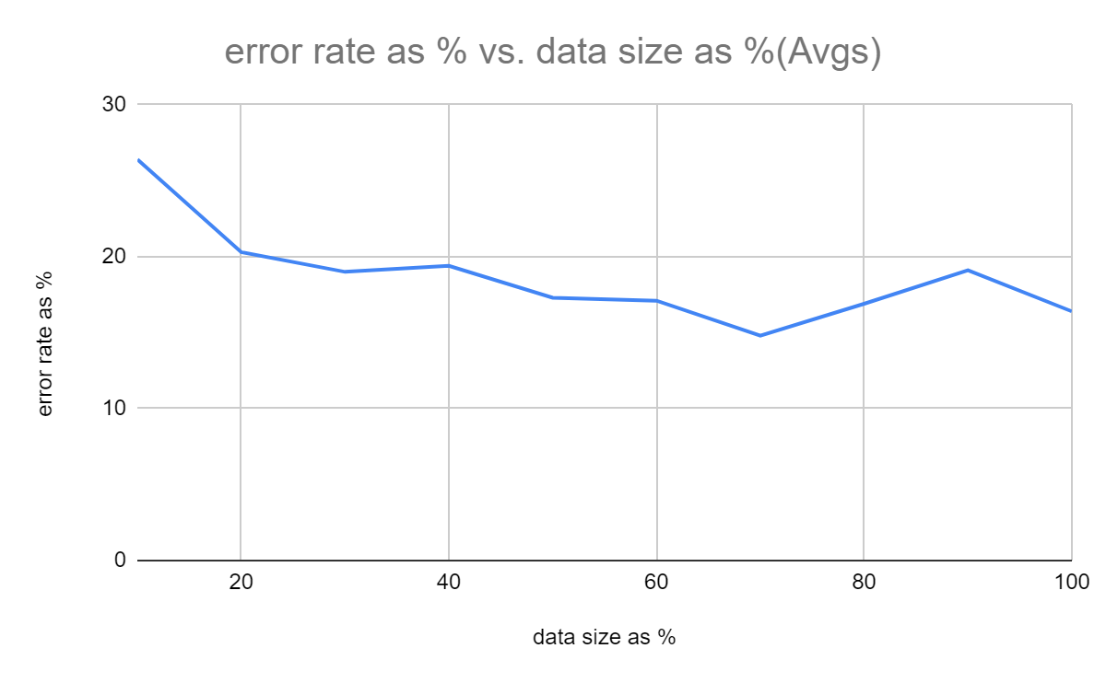
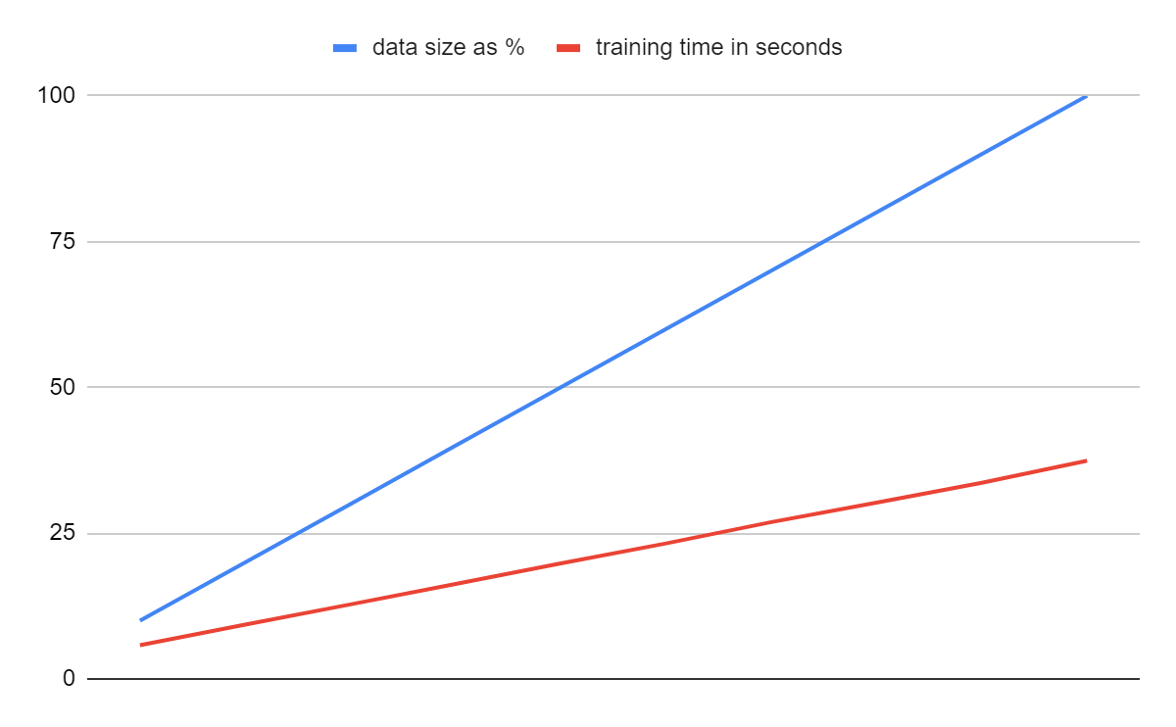
Perceptron Digits Data

Slide 4
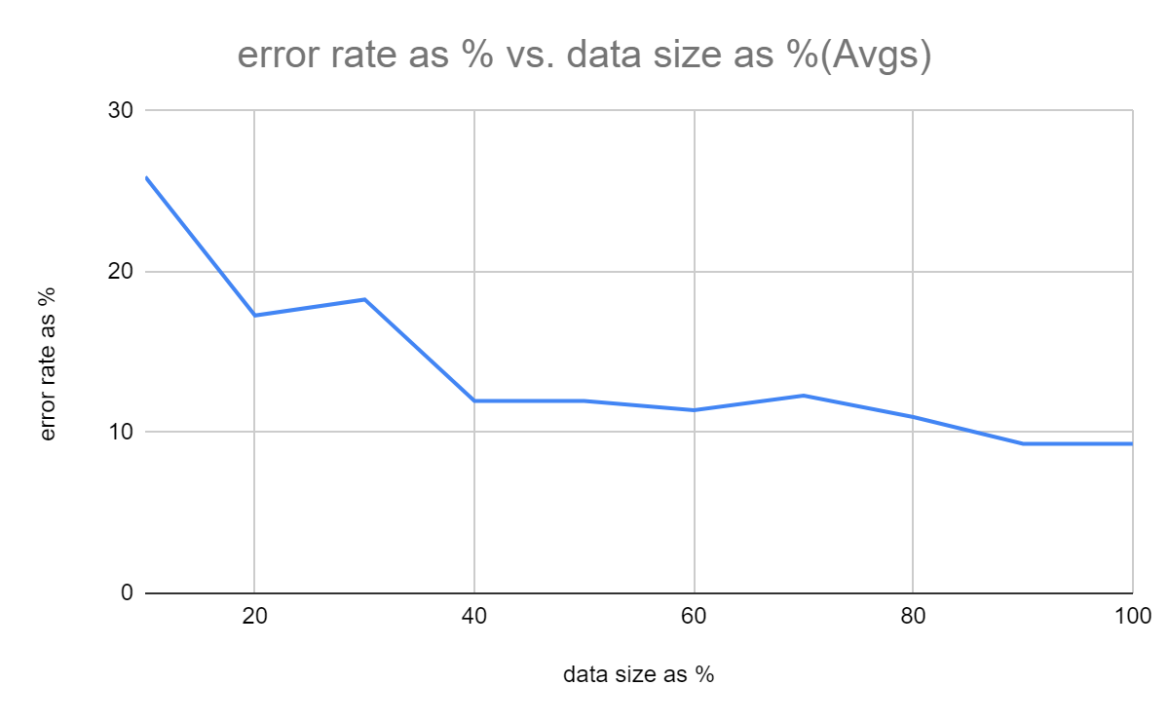
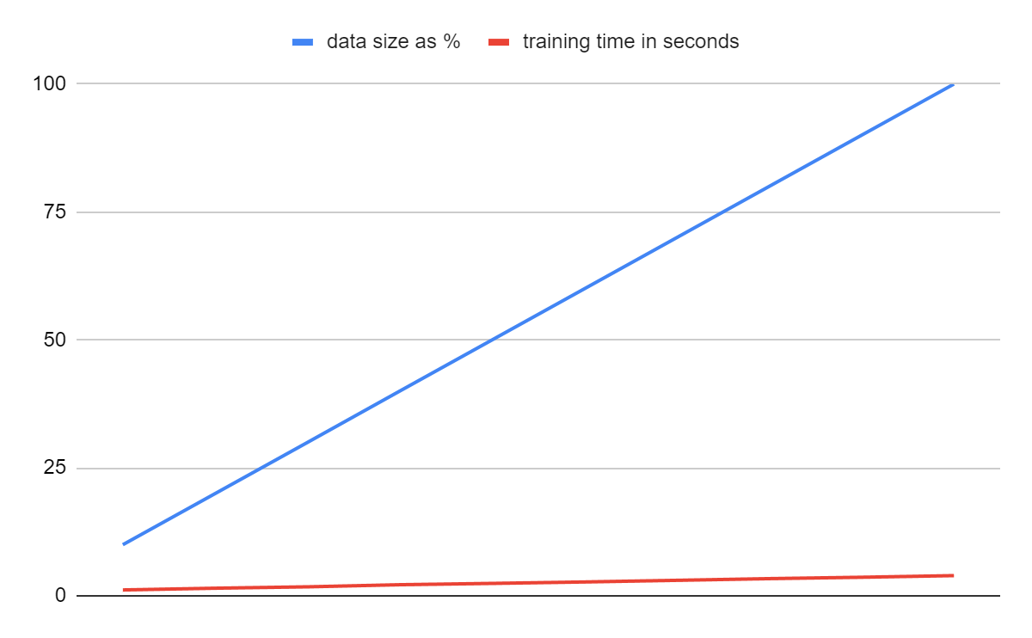
Perceptron Faces Data

Slide 5
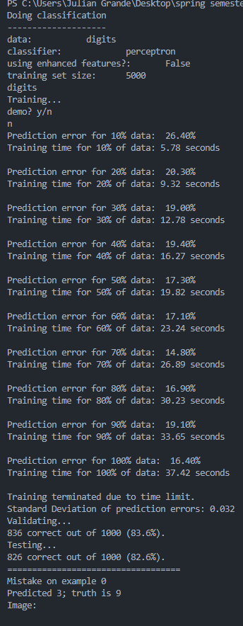
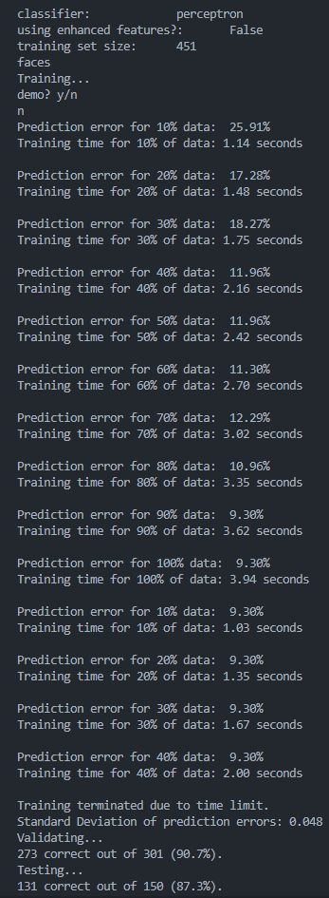
Perceptron Results
Left - Digits
~82.6%
Right - Faces
~87.3%

Slide 6
Neural Network
Neural Network coded from scratch but used YouTube video for framework: https://www.youtube.com/watch?v=9RN2Wr8xvro
Reads & handles data from Berkeley materials also (uses Counter objects)
How it works:
The input layer starts with original number of neurons - 784 for digits, 4200 for faces
Hidden layer has 20 neurons, each neuron is fully connected to the input layer
Output layer has either 10 neurons (digits) or 2 neurons (faces)

Slide 7
Neural Network (continued)
Forward Propagation
Each image’s data gets converted to pixel_vector, a 2d vector that is either 0 (empty) or 1 (gray/black/edge?). Each element in this vector represents a neuron in the input layer.
From the input to the hidden layer, we calculate a weighted sum and put it through the sigmoid function.
From the hidden to output layer, we also calculate a weighted sum and then put it through the sigmoid function.
(These weighted sums are typically bias plus the product of matrix multiplication from the weight matrix and input data.)
Backward Propagation
We calculate an output error calculation by subtracting the network’s prediction by the true label.
From the output to the hidden layer, we calculate a weight gradient which shows how each weight contributed to any error.
Weights and biases get updated by using this gradient as well as a learn rate.
In the hidden layer, we calculate an error propagation, essentially just how much each neuron in hidden layer contributed to output error. Then, the hidden layer weights get updated again as well as the biases.

Slide 8
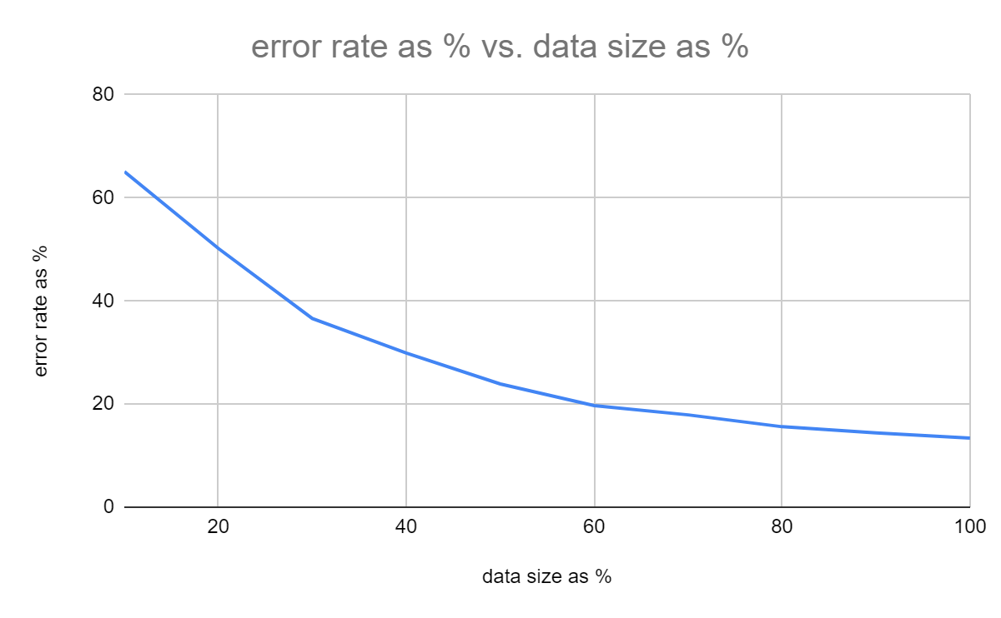
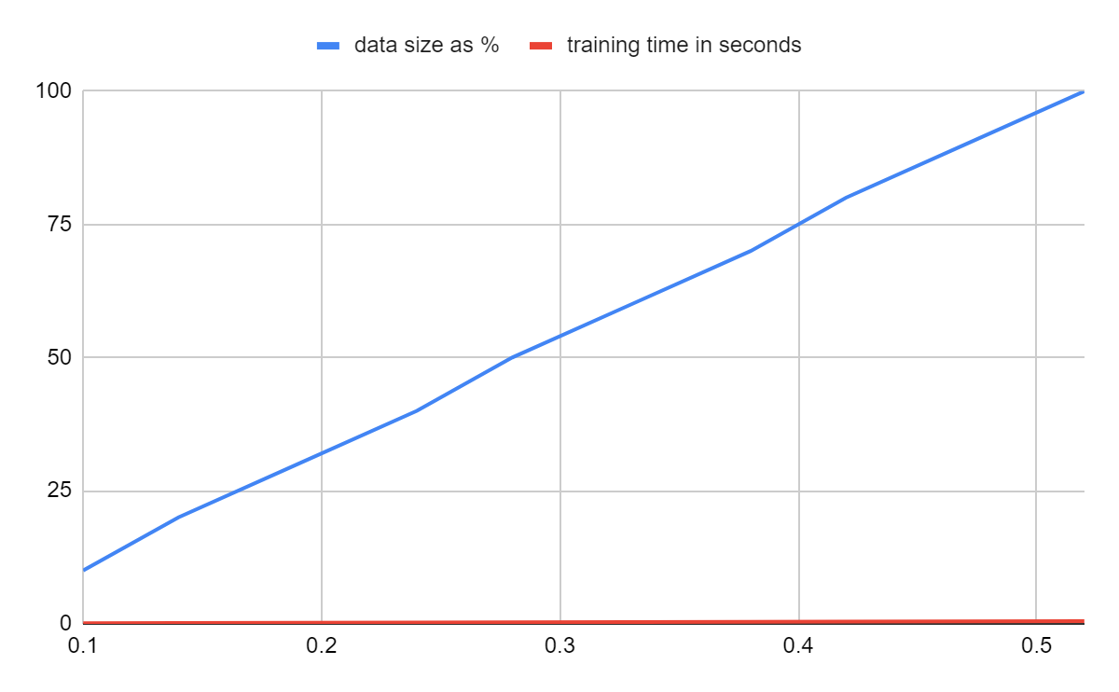
NN Digits Data

Slide 9
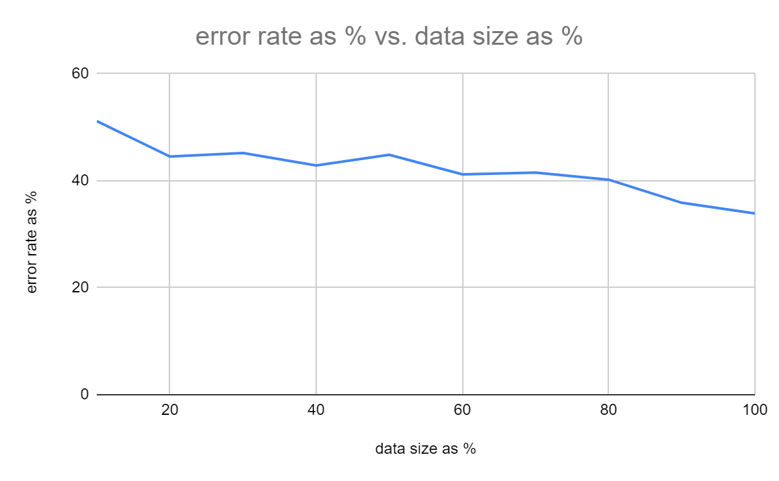
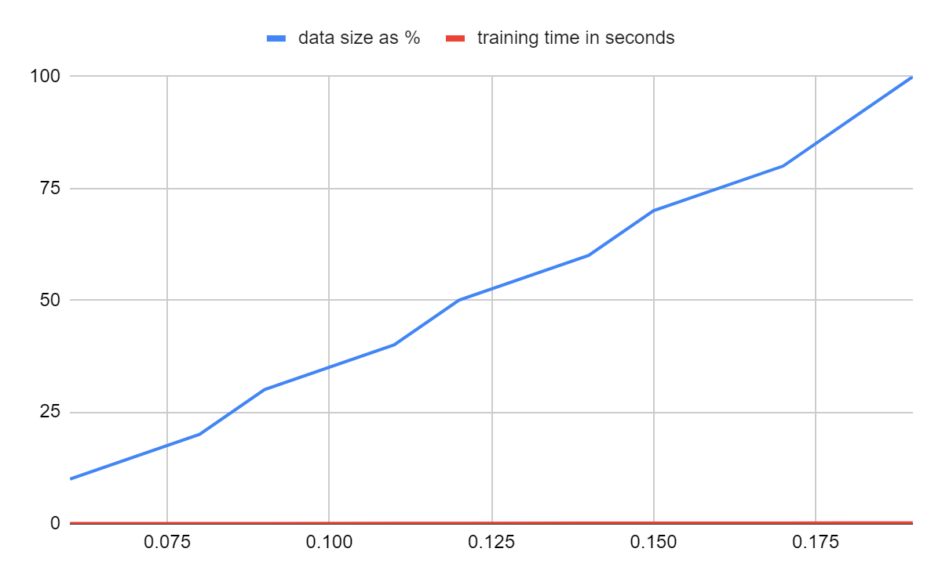
NN Faces Data

Slide 10
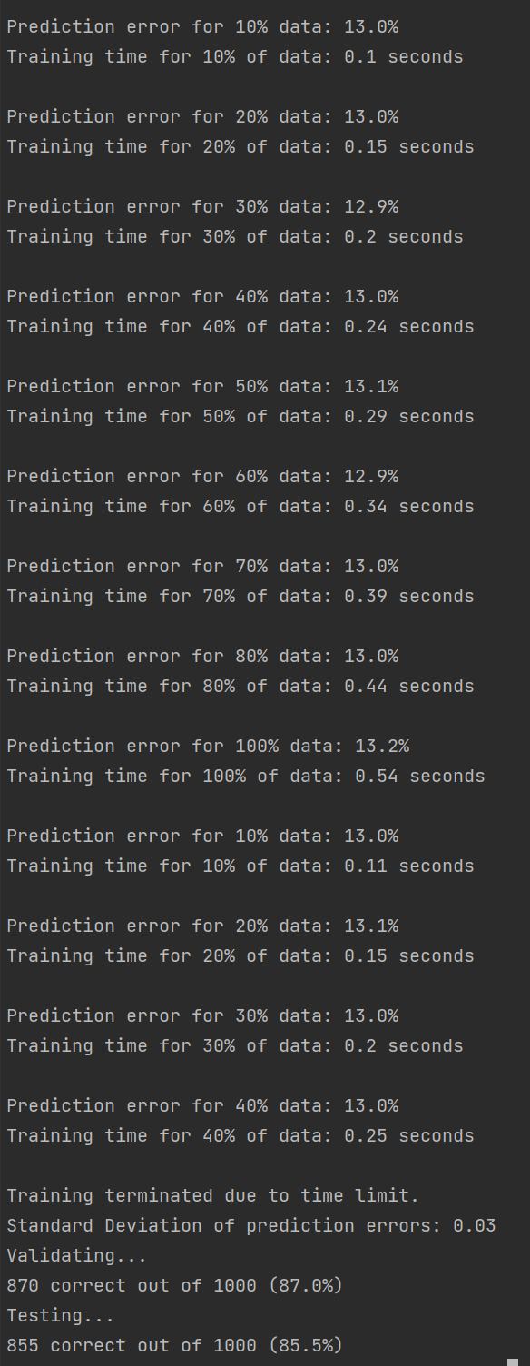
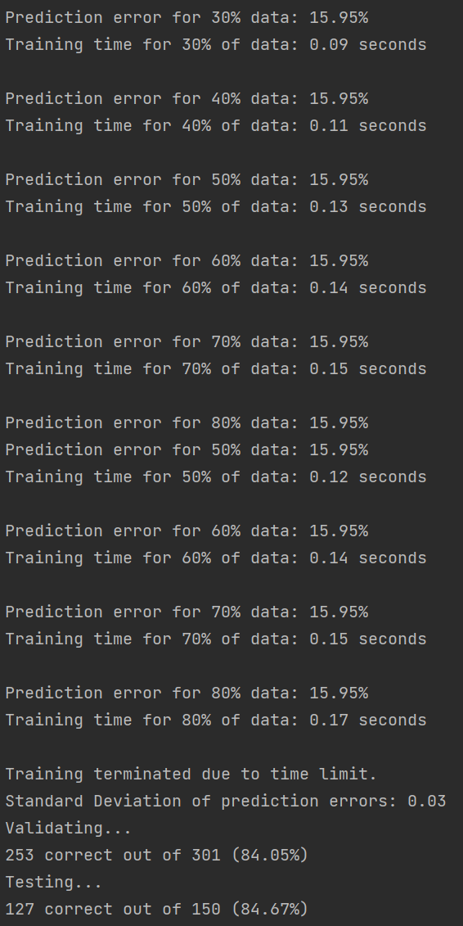
NN Results
Left - Digits
~85.5%
Right - Faces
~84.68%

Slide 11
Comparison: Perceptron vs. Neural Network
Both Perceptron and the Two Layer Neural Network got better at classifying digits and faces as more of the training data was used
Two Layer Neural Network was slightly better at recognizing digits than Perceptron
In comparison to Perceptron, the Two Layer Neural Network was significantly faster at training the data on both faces and digits data sets
Perceptron took significantly longer to train for digits, likely do to such a large size of data and only being a single layer
The standard deviation of the prediction error as a function of % of training data used was similar although the Two Layer Neural Network was slightly better than Perceptron in regards to the faces dataset
Overall Testing accuracy for both models was similar, with Two Layer Neural network slightly better at recognizing digits
* Only ran for one epoch of randomized samples

